Slide 1




Slide 2

MIXTURES AND ALLIGATIONS

Slide 3

Test time on : Ratio and Proportion
QR CODE:

Slide 4
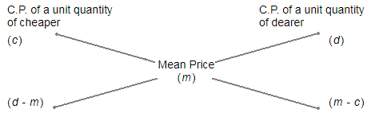
CONCEPTS
(Cheaper quantity) : (Dearer quantity) = (d - m) : (m - c).
Suppose a container contains x of liquid from which y units are taken out and replaced by water.
After n operations, the quantity of pure liquid = [x(1-(y/x))^n] units

Slide 5
Question: 01
In what ratio must rice at Rs 9.30 per kg be mixed with rice at
Rs 10.80 per kg so that the mixture be worth Rs 10 per kg?
A. 6:5
B. 8:7
C. 3:7
D. 6:1
Answer : B

Slide 6
Explanation: 01
C.P of 1 Kg C.P of 1 Kg
rice of 1st rice of 2nd
kind (930p) kind (1080p)
\ / Mean Price
(1000p)
/ \
(1080 – 1000) : (1000 - 930)
80 70
Thus, required ratio = 80 : 70 = 8 : 7
Notes:
D

Slide 7
Question: 02
How much water must be added to 60 litres of milk at 1 (½)
litres for Rs. 20 so as to have a mixture worth Rs.10 (⅔) a litre?
A. 10 litres
B. 12 litres
C. 15 litres
D. 18 litres
Answer : C

Slide 8
Explanation: 02
1(½) = Rs 20
1 litre = 20 * ⅔ = 40/3
C.p of 1 litre of water C.P of 1 litre milk
0 40/3
32/3
(40/3-32/3)=8/3 32/3 -0 = 32/3
Ratio = 8/3:32/3= 1:4 = ¼ * 60 =15 litres
Notes:
D

Slide 9
Question: 03
In what ratio must wheat at Rs. 3.20 per kg be mixed with
wheat at Rs. 2.90 per kg so that the mixture be worth Rs. 3.08 per kg?
A. 3 : 4
B. 2 : 3
C. 3 : 2
D. 4 : 3
Answer : C

Slide 10
Explanation: 03
C.P of a unit quantity of 1st kind = Rs. 3.20 C.P of a unit quantity of 2nd kind = Rs. 2.90 Mean price = Rs.3.08
C.P of unit quantity C.P of unit quantity
of 1st kind of 2nd kind
(Rs. 3.20) (Rs. 2.90)
\ / Mean Price
(Rs.3.08)
/ \
(3.08 – 2.90) : (3.20 – 3.08)
0.18 0.12
Required ratio = 0.18 : 0.12 = 3 : 2
Notes:
D

Slide 11
Question: 04
In what proportion must rice at Rs. 3.10 per kg be mixed with
rice at Rs. 3.60 per kg so that the mixture be worth Rs. 3.25 per kg?
A. 3 : 7
B. 5 : 3
C. 3 : 5
D. 7 : 3
Answer : D

Slide 12
Explanation: 04
C.P of a unit quantity of 1st kind = 310p (in paise) C.P of a unit quantity of 2nd kind = 360p Mean price = 325p
C.P of unit quantity C.P of unit quantity
of 1st kind of 2nd kind
(310p) (360p)
\ / Mean Price
(325p)
/ \
(360 – 325) : (325 – 310)
35 15
Required ratio = 35 : 15 = 7 : 3 They must be mixed in the ratio 7 : 3
Notes:
D

Slide 13
Question: 05
In what ratio must tea at Rs. 62 per kg be mixed with tea at
Rs. 72 per kg so that the mixture must be worth Rs. 64.50 per kg?
A. 1 : 3
B. 2 : 3
C. 3 : 1
D. 3 : 2
Answer : C

Slide 14
Explanation: 05
C.P of a unit quantity of 1st kind = Rs. 62 C.P of a unit quantity of 2nd kind = Rs. 72 Mean price = Rs. 64.50
C.P of unit quantity C.P of unit quantity
of 1st kind of 2nd kind
(Rs. 62) (Rs. 72)
\ / Mean Price
(Rs. 64.50)
/ \
(72 – 64.50) : (64.50 – 62)
7.50 2.50
Required ratio = 7.50 : 2.50 = 3 : 1
Notes:
D

Slide 15
Question: 06
The ratio, in which tea costing Rs. 192 per kg is to be mixed
with tea costing Rs. 150 per kg so that the mixed tea when sold for Rs. 194.40 per kg, gives a profit of 20%.
A. 1:2
B. 2:5
C. 3:5
D. 3:7
Answer : B

Slide 16
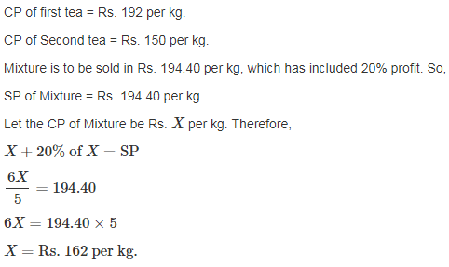
Explanation: 06
Notes:
D

Slide 17
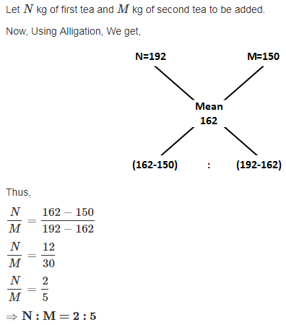
Explanation: 06

Slide 18
Question: 07
In a zoo, there are Rabbits and Pigeons. If heads are counted, there are 200 and if legs are counted, there are 580. How many pigeons are there?
A. 90
B. 100
C. 110
D. 120
Answer : C

Slide 19
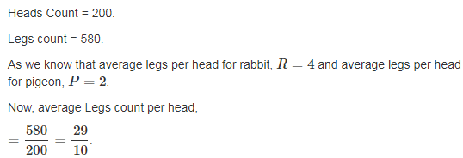
Explanation: 07
Notes:
D

Slide 20
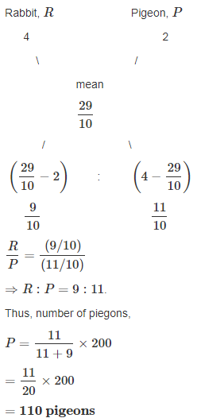
Explanation: 07

Slide 21
Question: 08
Weights of two friends Ram and Shyam are in the ratio 4:5.
If Ram's weight is increased by 10% and total weight of Ram and Shyam become 82.8 kg, with an increases of 15%, by what percent did the weight of Shyam has to be increased?
A. 17%
B. 19%
C. 23%
D. 29%
Answer : B

Slide 22
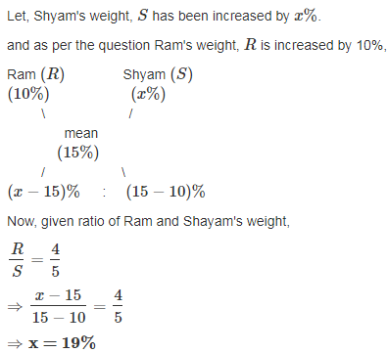
Explanation: 08
Notes:
D

Slide 23
Question: 09
In a 729 litres mixture of milk and water, the ratio of milk to water is 7.2.To get a new mixture containing milk and water in the ratio 7:3, the amount of water to be added is_________.
A. 51 litres
B. 61 litres
C. 71 litres
D. 81 litres
Answer : D

Slide 24
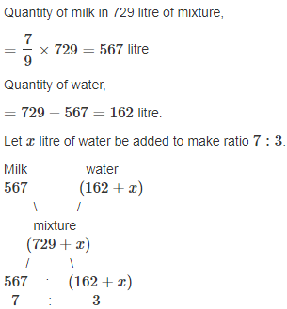
Explanation: 09
Notes:
D

Slide 25
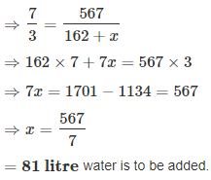
Explanation: 09

Slide 26
Question: 10
Three types of wheat of Rs. 1.27, Rs. 1.29 and Rs. 1.32 per kg are mixed together to be sold at Rs. 1.30 per kg. In what ratio should this wheat be mixed?
A. 1:2:3
B. 1:1:2
C. 2:1:3
D. 2:2:3
Answer : B

Slide 27
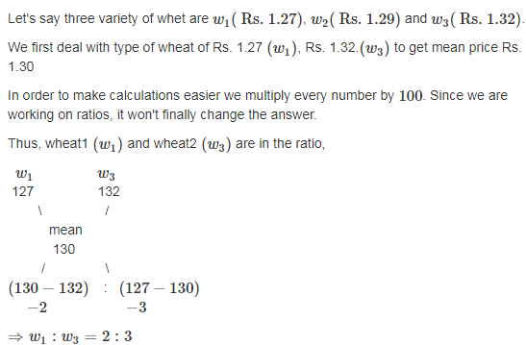
Explanation: 10
Notes:
D

Slide 28
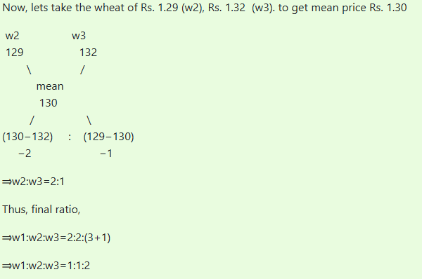
Explanation: 10
Notes:
D

Slide 29
Question: 11
The milk and water in two vessels A and B are in the ratio 4:3 and 2:3 respectively. In what ratio the liquids in both the vessels be mixed to obtain a new mixture in vessel c consisting half milk and half water?
A. 8 : 3
B. 7 : 5
C. 4 : 3
D. 2 : 3
Answer : B

Slide 30
Explanation: 11
Milk in 1 litre mixture of A = 4/7 litre.
Milk in 1 litre mixture of B = 2/5 litre.
Milk in 1 litre mixture of C = 1/2 litre.
By rule of alligation we have required ratio X:Y
Notes:
D

Slide 31
Explanation: 11
X : Y
4/7 2/5
\ /
(Mean ratio) (1/2)
/ \
(1/2 – 2/5) : (4/7 – 1/2)
1/10 1/1 4
So Required ratio = X : Y = 1/10 : 1/14 = 7:5

Slide 32
Question: 12
Two vessels A and B contain spirit and water mixed in the ratio 5:2 and 7:6 respectively. Find the ratio in which these mixture be mixed to obtain a new mixture in vessel c containing spirit and water in the ratio 8:5?
A. 1 : 7
B. 2 : 9
C. 7 : 9
D. 3 : 8
Answer : C

Slide 33
Explanation: 12
Spirit in 1 litre mix of A = 5/7 litre.
Spirit in 1 litre mix of B = 7/13 litre.
Spirit in 1 litre mix of C = 8/13 litre.
By rule of alligation we have required ratio X:Y
X : Y
5/7 7/13
\ /
(8/13)
/ \
(1/13) : (9/91) => 7:9 Therefore required ratio = 1/13 : 9/91
=7: 9
Notes:
D

Slide 34
Question: 13
How many kilograms of sugar costing Rs. 9 per kg must be mixed with 27 kg of sugar costing Rs.7 per kg so that there may be gain of 10% by selling the mixture at Rs. 9.24 per kg?
A. 60 kg
B. 63 kg
C. 50 kg
D. 77 kg
Answer : B

Slide 35
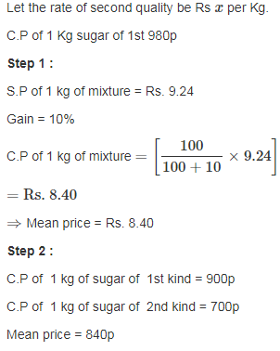
Explanation: 13
Notes:
D

Slide 36
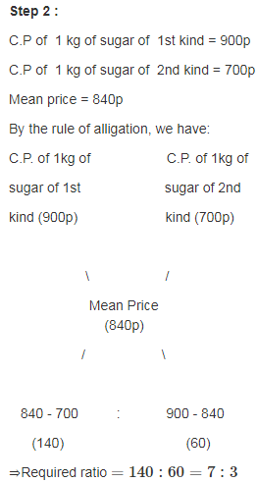
Explanation: 13

Slide 37
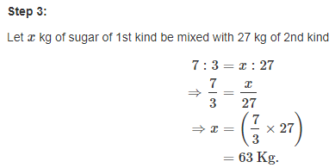
Explanation: 13

Slide 38
Question: 14
One quantity of wheat at Rs 9.30 per kg is mixed with another quality at a certain rate in the ratio 8:7. If the mixture so formed be worth Rs 10 per kg, what is the rate per kg of the second quality of wheat?
A. Rs. 12.47
B. Rs. 10.80
C. Rs. 15.17
D. Rs. 47.66
Answer : B

Slide 39
Explanation: 14
Let the rate of second quality be Rs x per Kg.
C.P of 1Kg wheat of 1st kind = 930p
C.P of 1 Kg wheat of 2nd kind = 100x p
Mean price = 1000p
By rule of alligation we have required ratio 8 : 7
930 x
\ /
(Mean Price) (10)
/ \
x-10 : 0.7 :: 8 : 7
we get required ratio, (x-10) : 0.7 :: 8 : 7
⇒ x = 10.80 per Kg
Notes:
D

Slide 40
Question: 15
A can contains a mixture of two liquids A and B in the ratio 7:5 when 9 litres of mixture are drawn off and the can is filled with B, the ratio of A and B becomes 7:9. How many litres of liquid A was contained by the can initially?
A. 28 litres
B. 21 litres
C. 45 litres
D. 36 litres
Answer : B

Slide 41
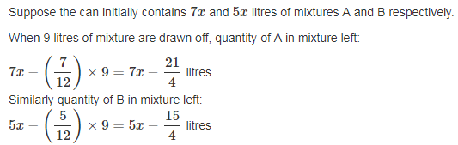
Explanation: 15
Notes:
D

Slide 42
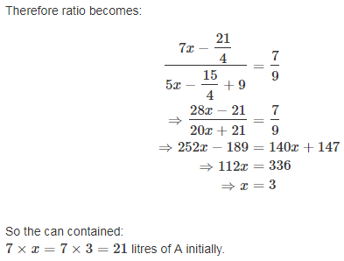
Explanation: 15

Slide 43

https://learn.codemithra.com

Slide 44




THANK YOU
+91 78150 95095
codemithra@ethnus.com
www.codemithra.com

